Slide 1
AJAX
Asynchronous JavaScript and XML

Slide 2
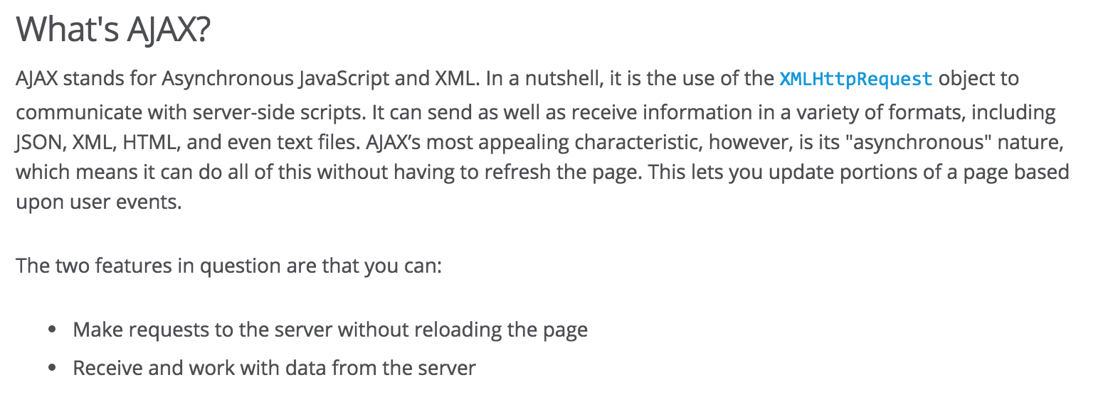
https://developer.mozilla.org/en-US/docs/AJAX/Getting_Started

Slide 3
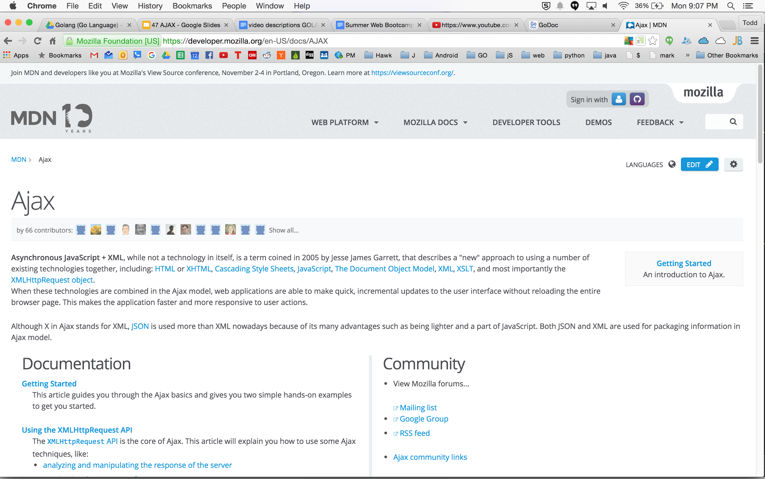

Slide 4
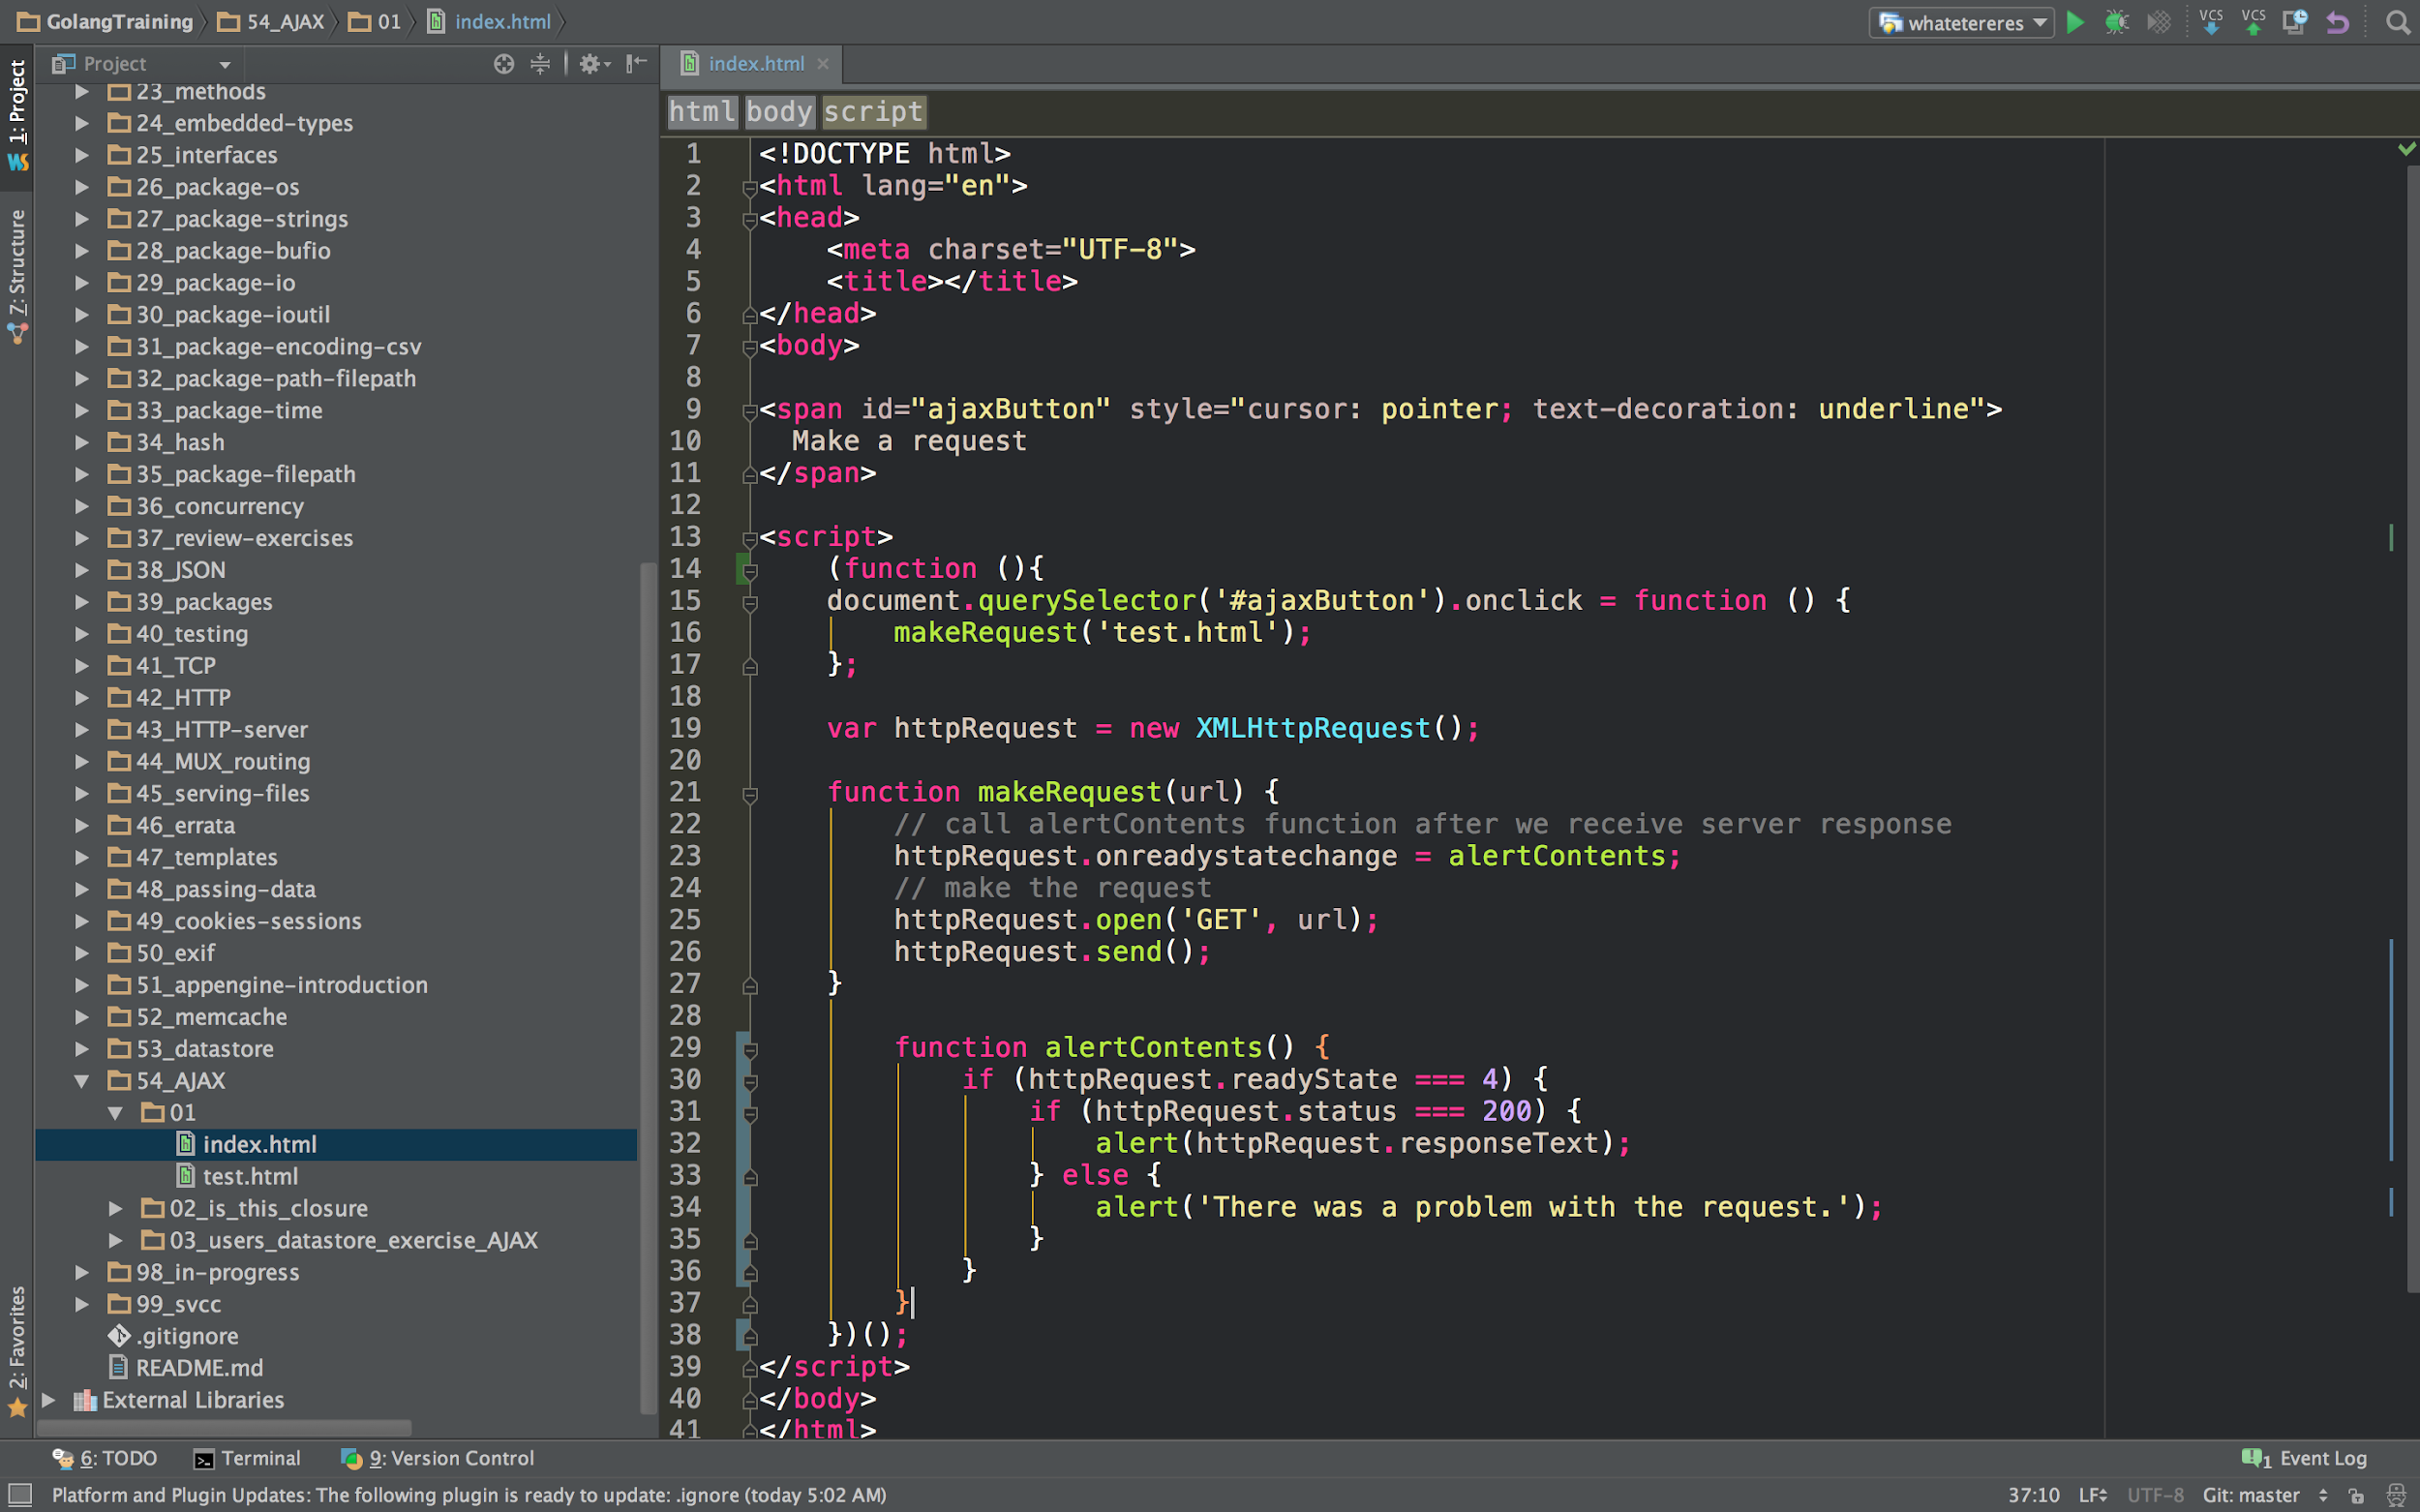

Slide 5
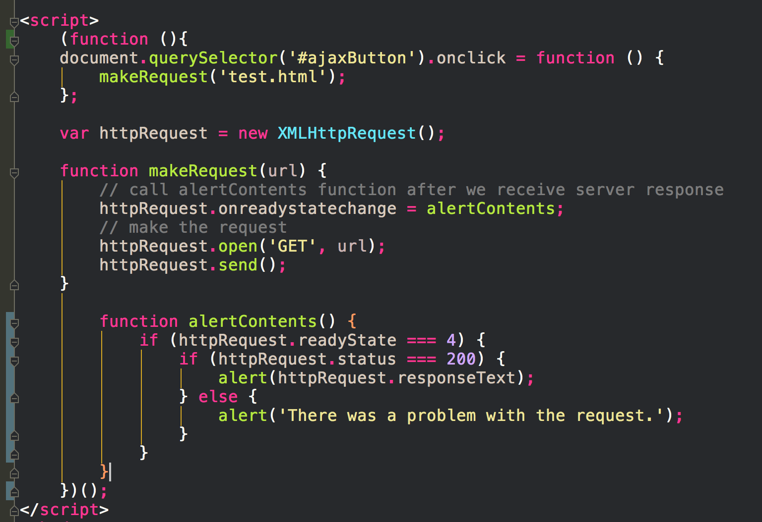

Slide 8
documentation

Slide 9
make an HTTP request

Slide 10
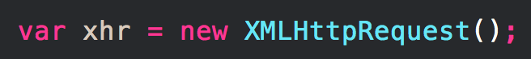
In order to make an HTTP request to the server using JavaScript, you need an instance of a class that provides this functionality.
https://developer.mozilla.org/en-US/docs/AJAX/Getting_Started

Slide 11
Tell the HTTP request object which JavaScript function will handle processing the response from the server. Set the onreadystatechange property of the object to the name of the JavaScript function that should be called when the state of the request changes.
xhr.onreadystatechange = nameOfTheFunction;
https://developer.mozilla.org/en-US/docs/AJAX/Getting_Started

Slide 12
Tell the HTTP request object which JavaScript function will handle processing the response from the server. Set the onreadystatechange property of the object to the name of the JavaScript function that should be called when the state of the request changes.
xhr.onreadystatechange = function(){
// process the server response
};
https://developer.mozilla.org/en-US/docs/AJAX/Getting_Started

Slide 13
After you've declared what will happen as soon as you receive the response, you need to actually make the request. You need to call the open() and send() methods of the HTTP request class
xhr.onreadystatechange = function(){
// process the server response
};
xhr.open('GET','http://www.example.org/some.file', true); xhr.send(null);
https://developer.mozilla.org/en-US/docs/AJAX/Getting_Started

Slide 14
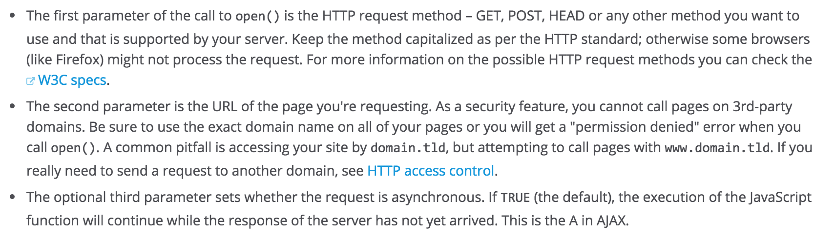
After you've declared what will happen as soon as you receive the response, you need to actually make the request. You need to call the open() and send() methods of the HTTP request class
xhr.onreadystatechange = function(){
// process the server response
};
xhr.open('GET','http://www.example.org/some.file', true); xhr.send(null);

Slide 15
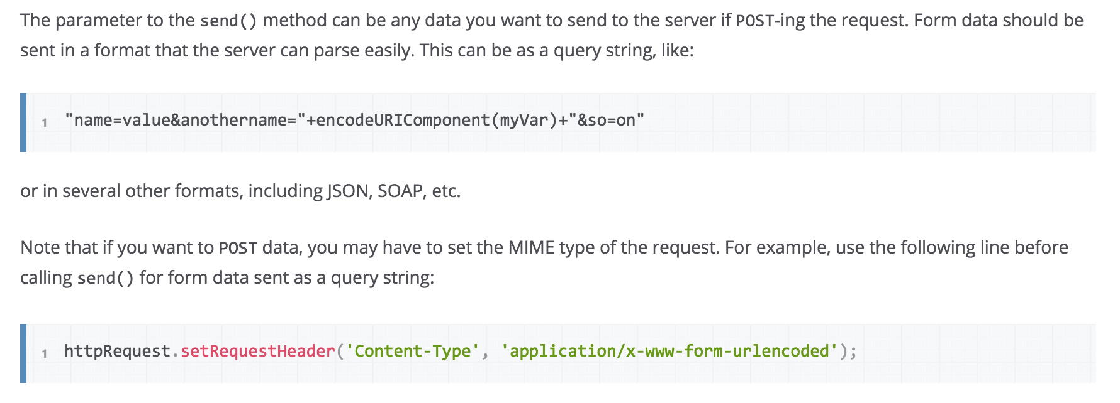
After you've declared what will happen as soon as you receive the response, you need to actually make the request. You need to call the open() and send() methods of the HTTP request class
xhr.onreadystatechange = function(){
// process the server response
};
xhr.open('GET','http://www.example.org/some.file', true); xhr.send(null);

Slide 16
handle the server response

Slide 17
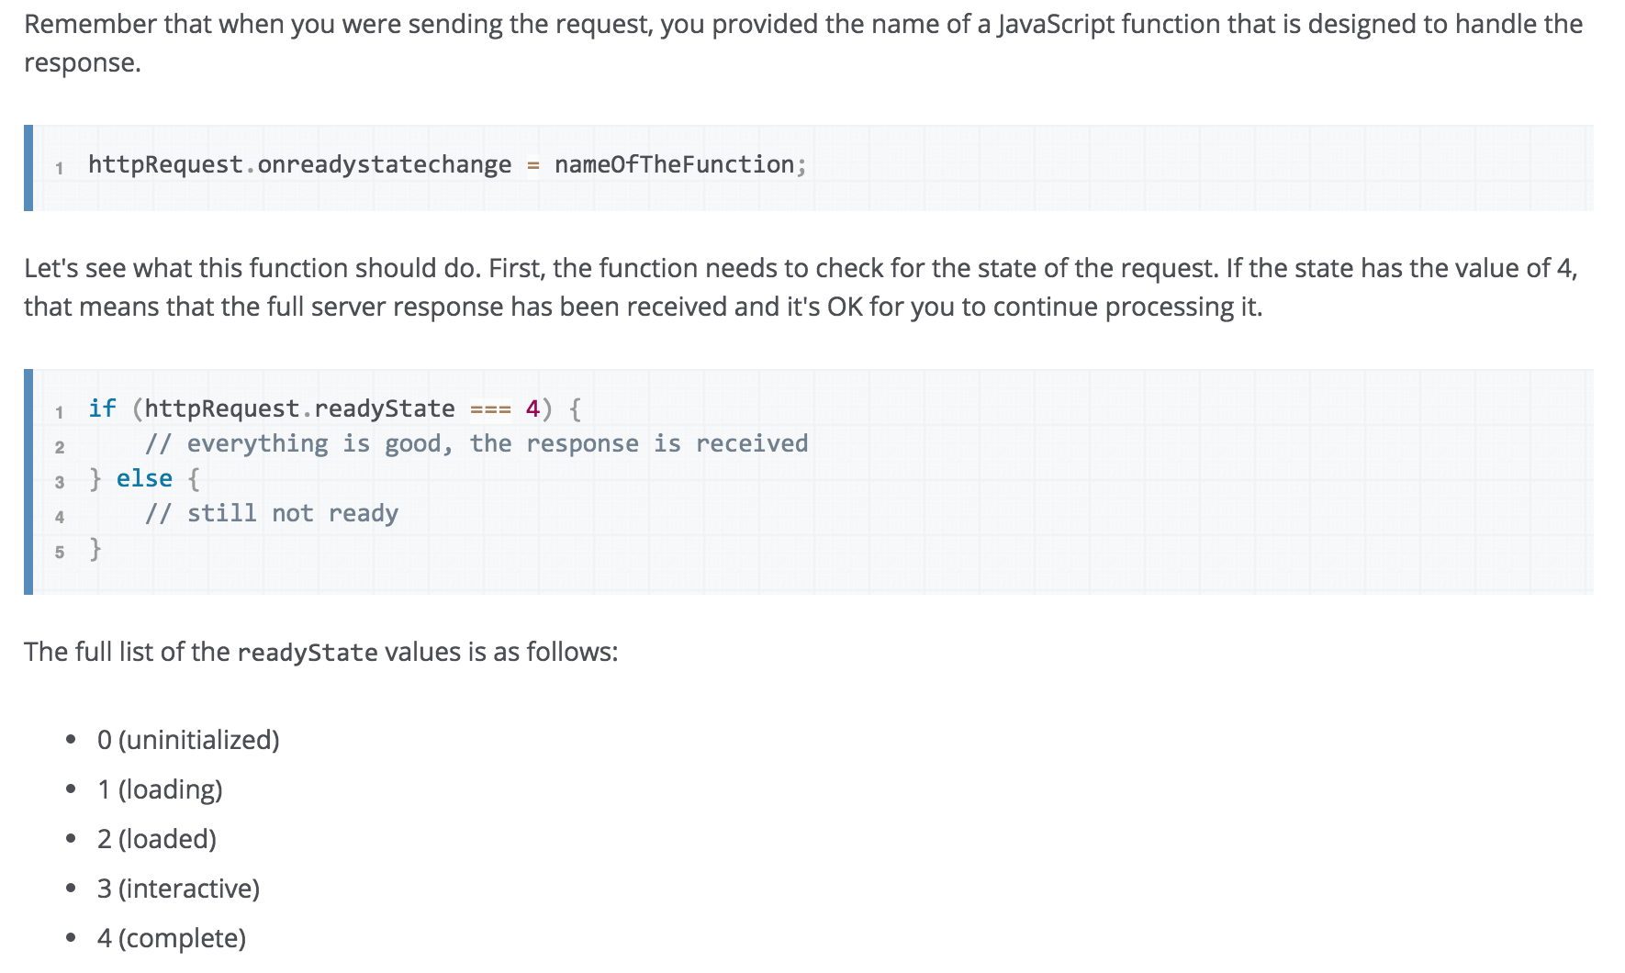
FYI, MDN calls their object httpRequest while I was calling it xhr
https://developer.mozilla.org/en-US/docs/AJAX/Getting_Started

Slide 18
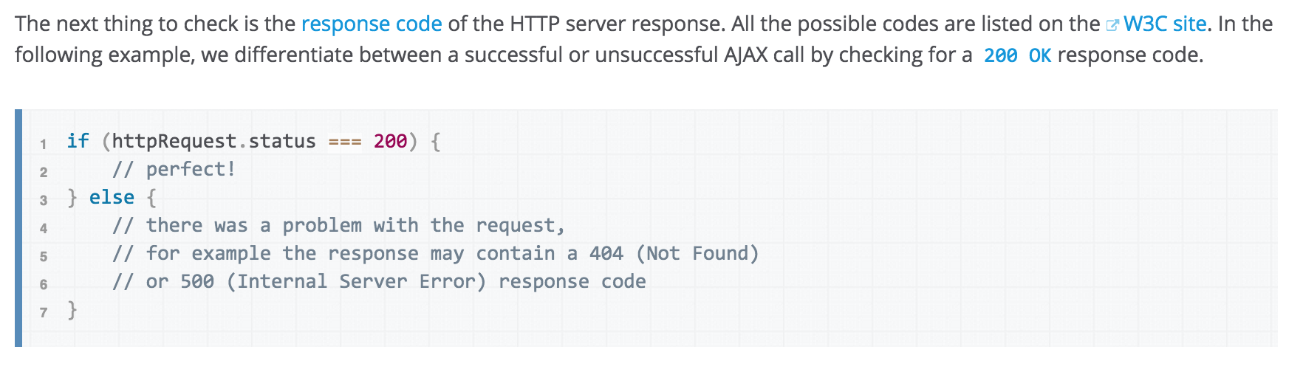
https://developer.mozilla.org/en-US/docs/AJAX/Getting_Started

Slide 19
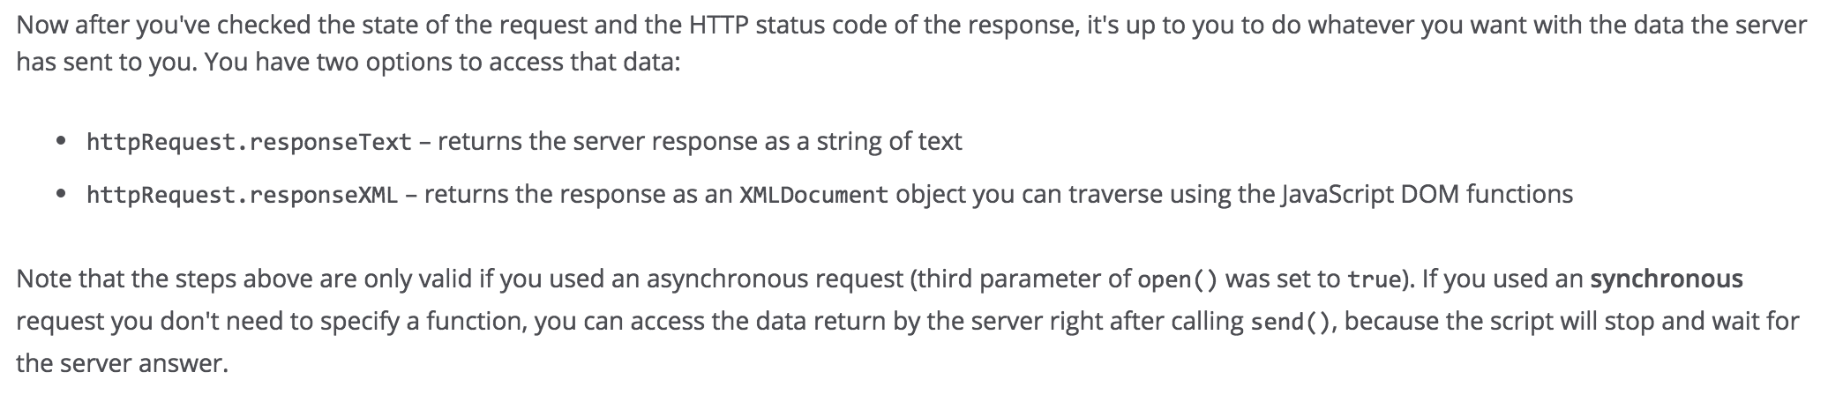
https://developer.mozilla.org/en-US/docs/AJAX/Getting_Started

Slide 20
App Engine & AJAX

Slide 21
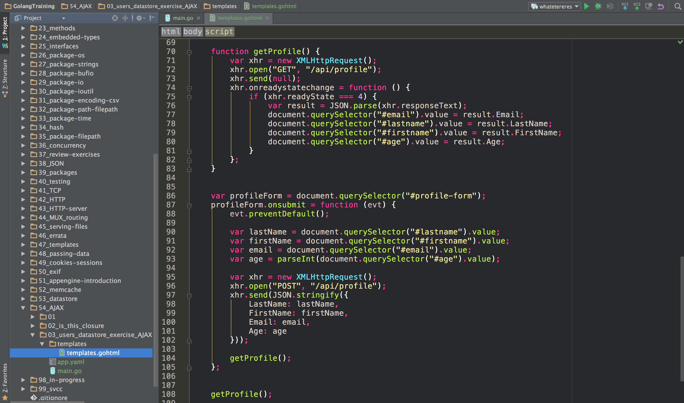

Slide 22
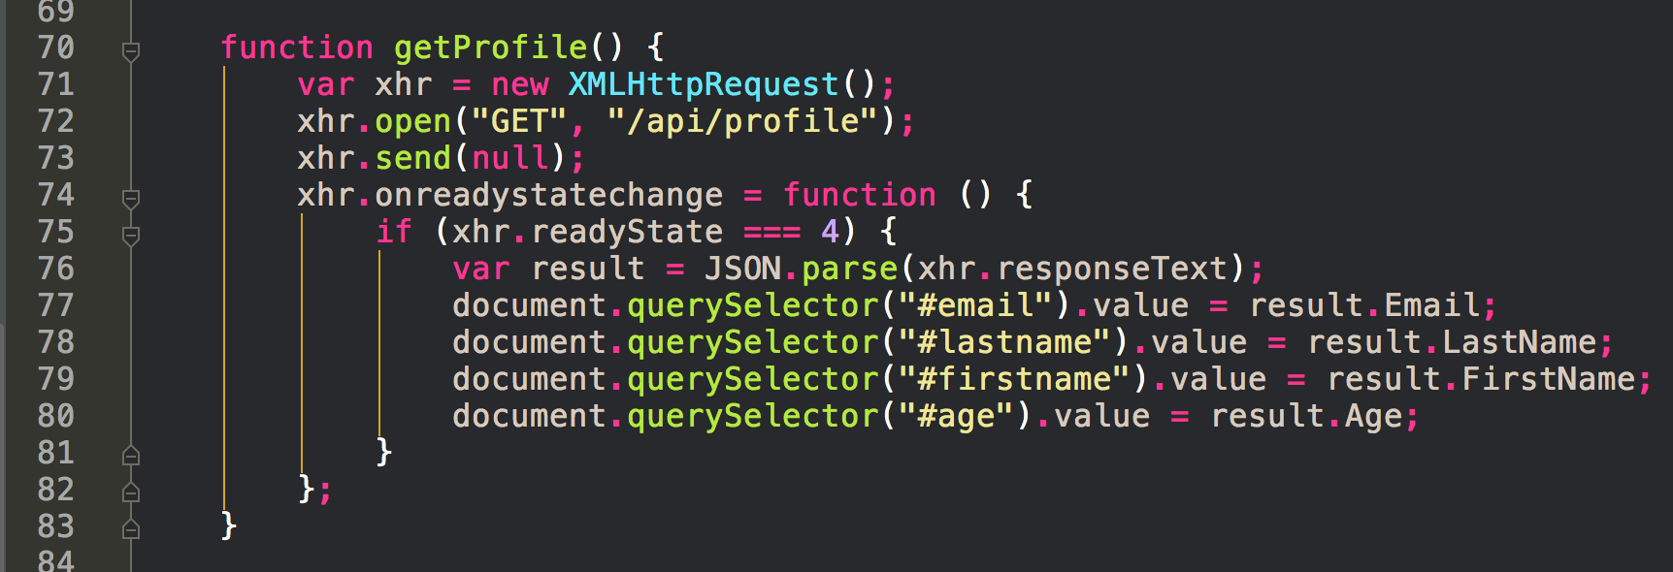

Slide 23
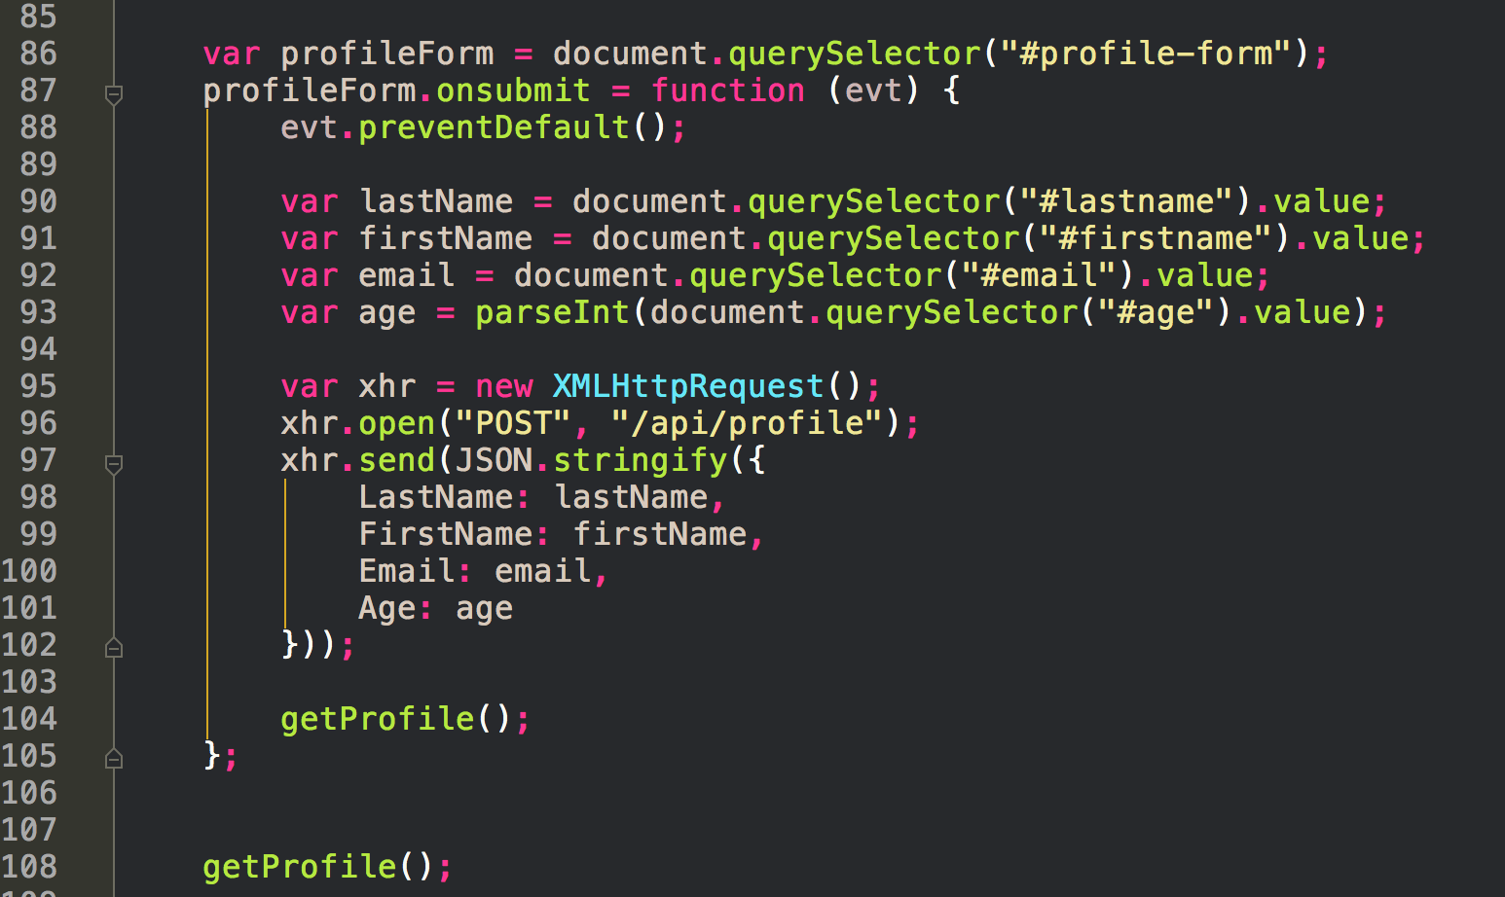

Slide 24
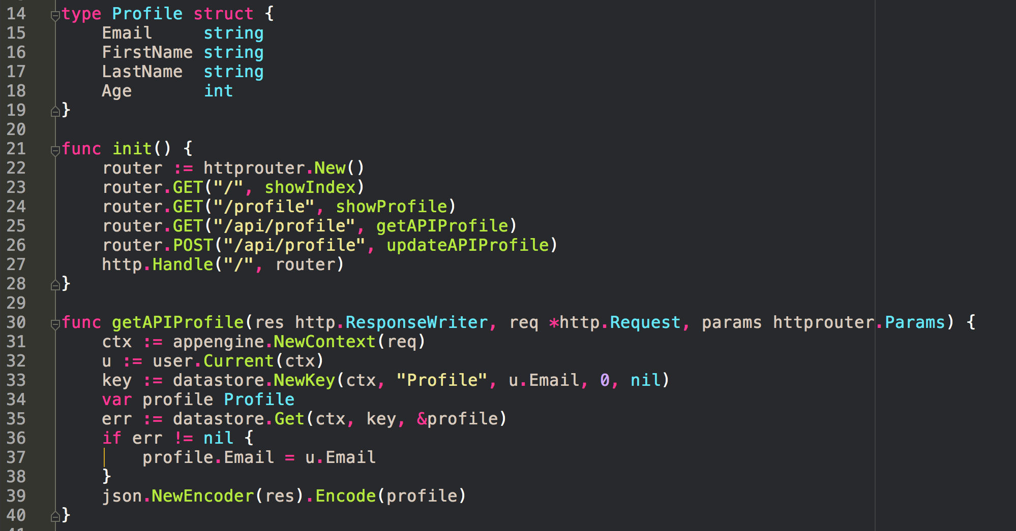

Slide 25
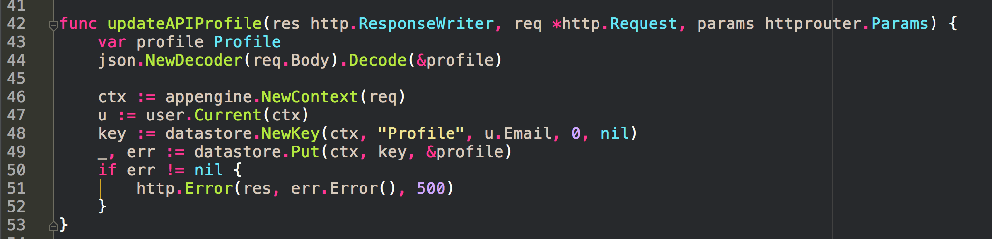

Slide 26
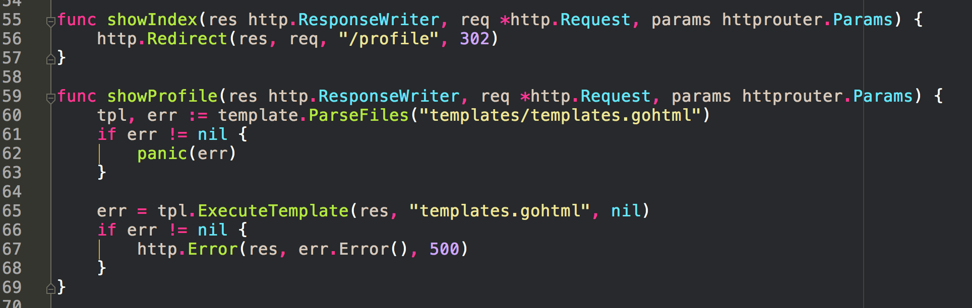

Slide 43
exercise solution AJAX

Slide 44
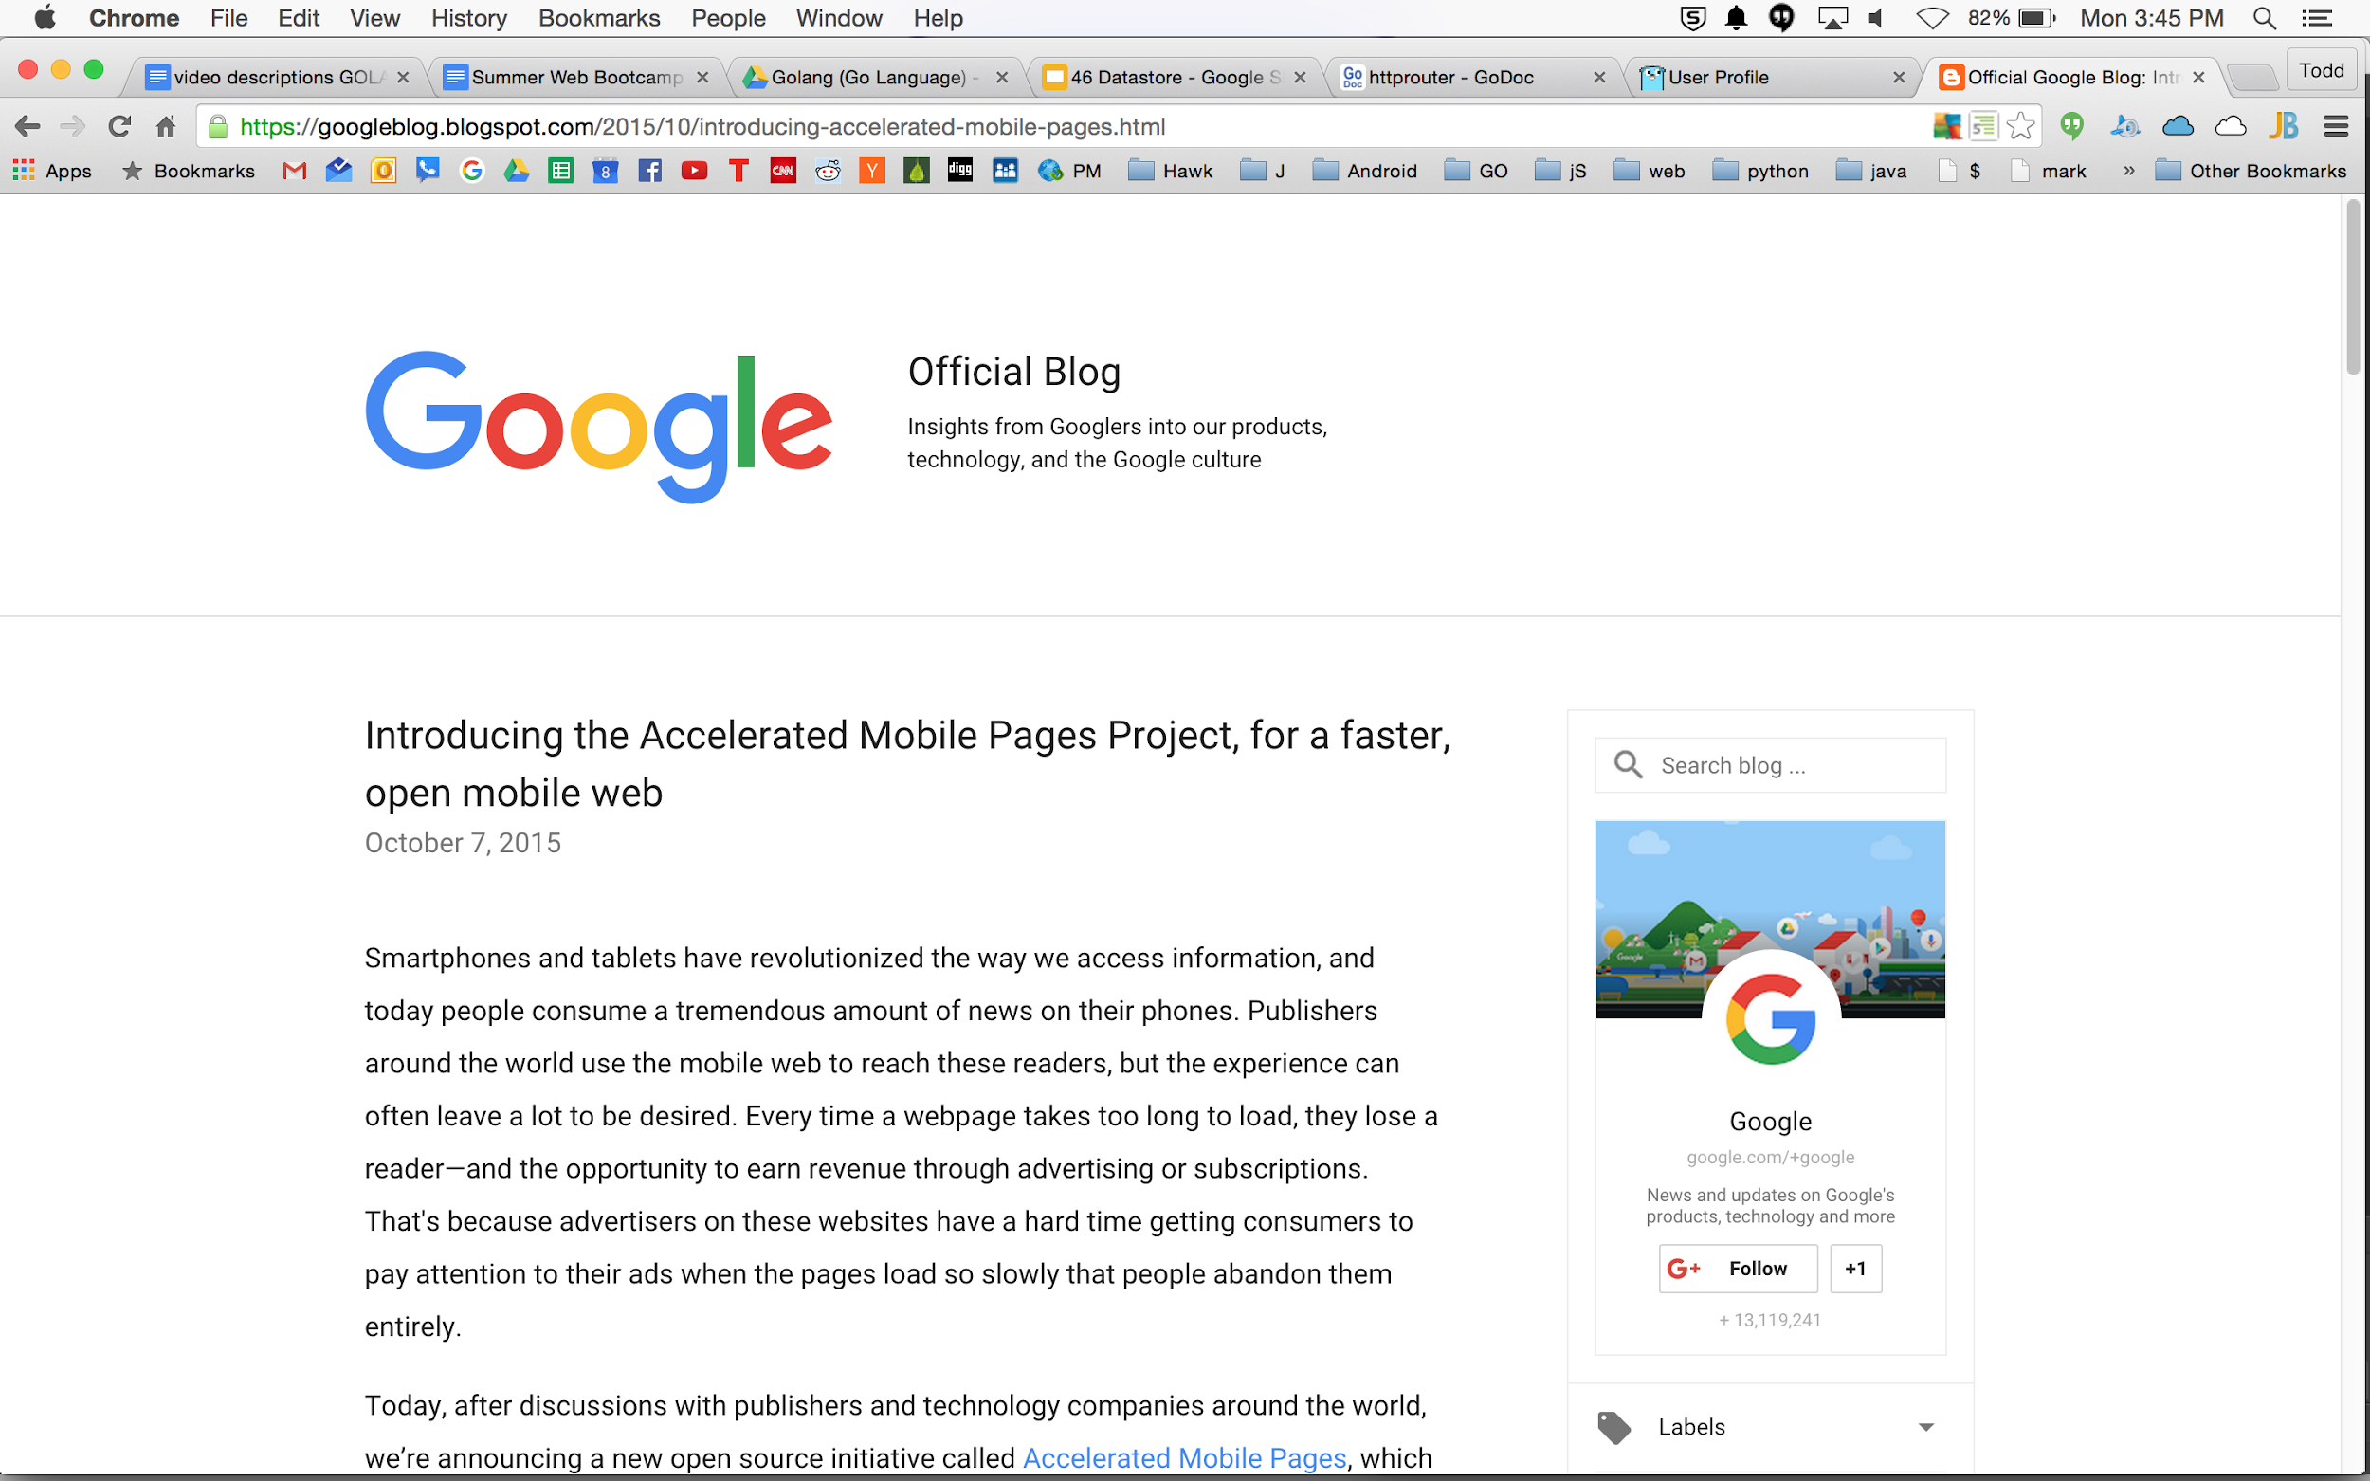

Slide 45
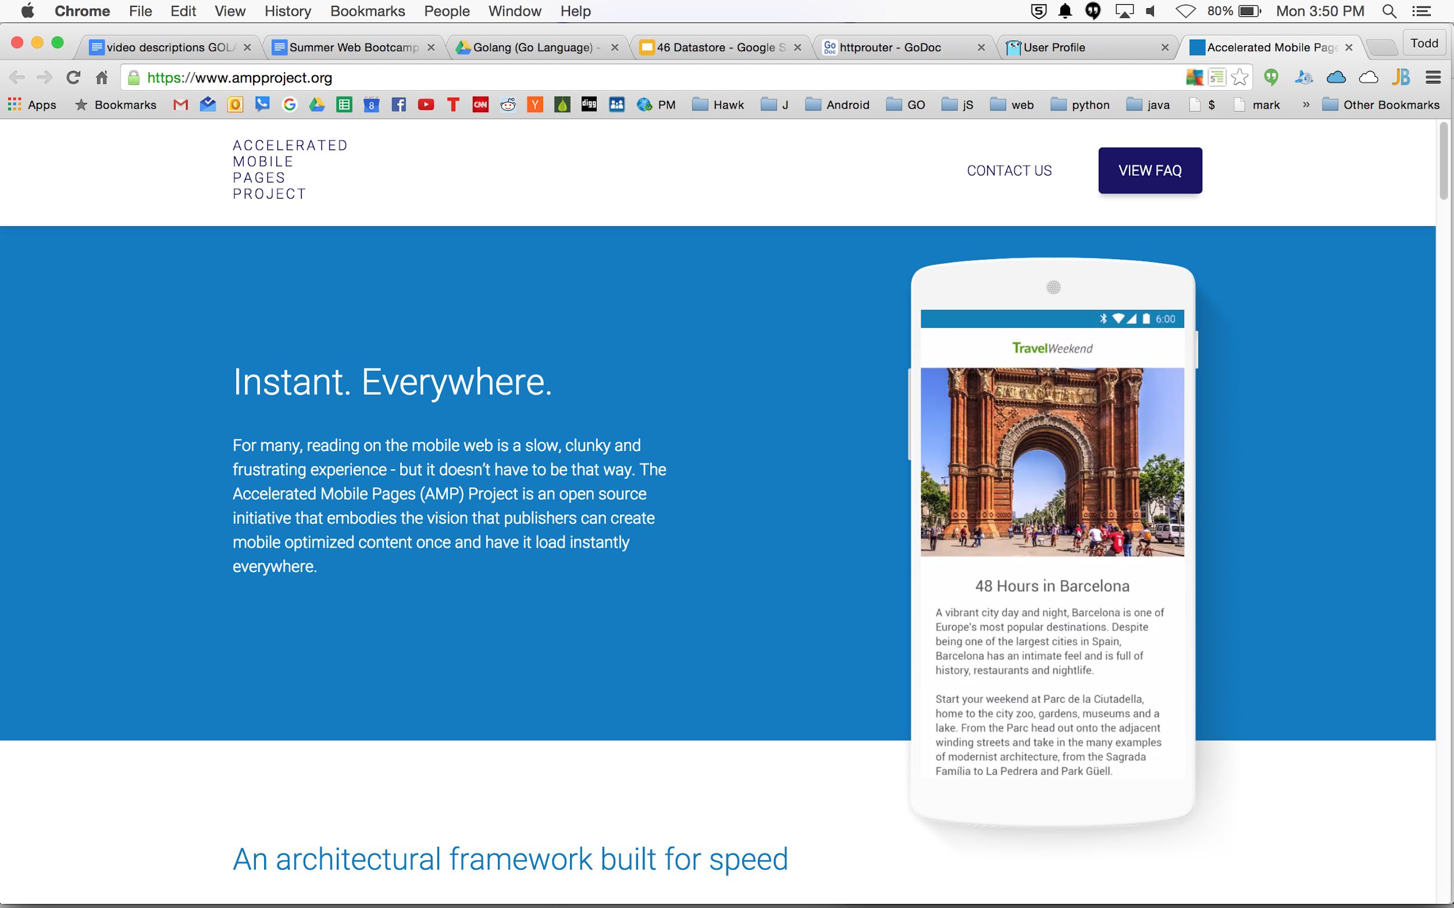

Slide 46
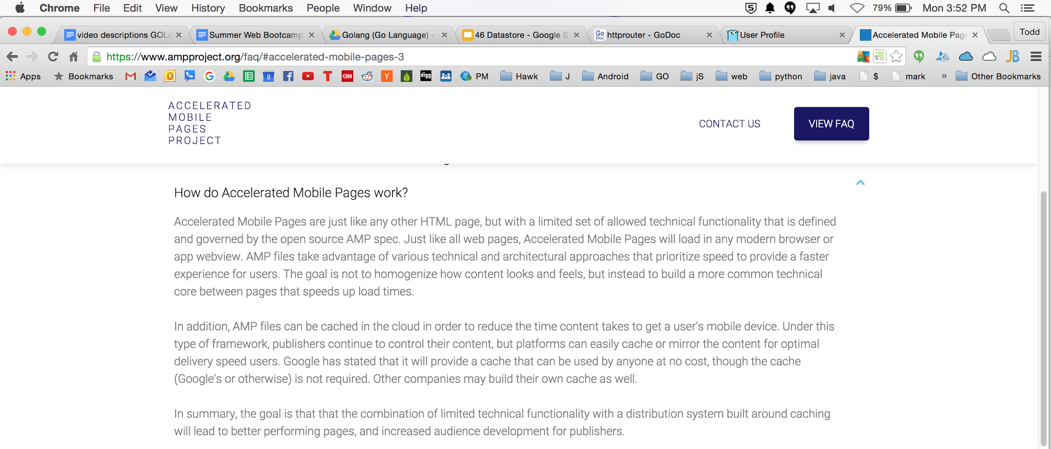

Slide 47
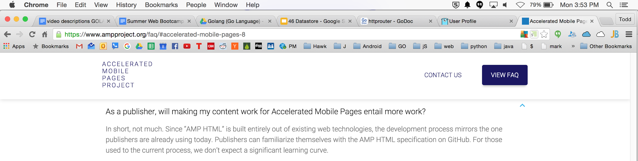

Slide 48
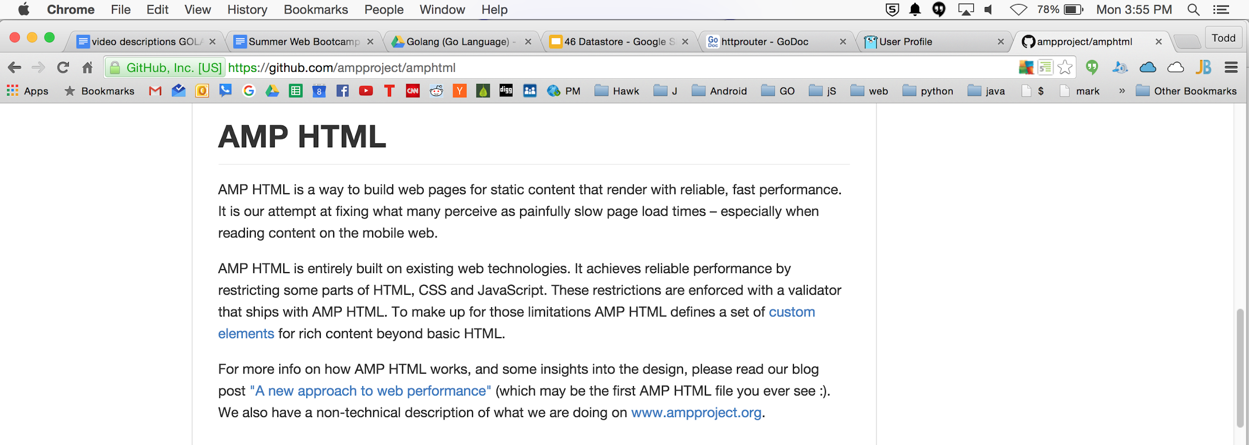

Slide 49
https://www.ampproject.org/how-it-works/

Slide 50
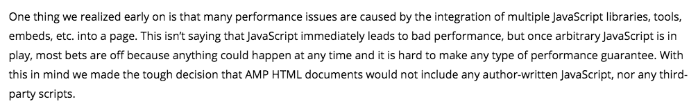

Slide 51
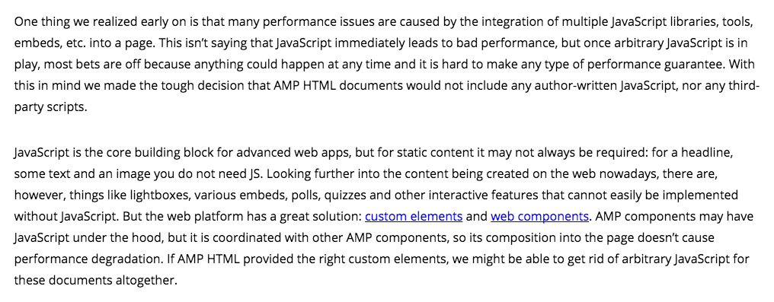

Slide 52
